Slide 1
Reinforcement Learning
Sreyash Mohanty-19BLC1177

Slide 2
What is Reinforcement Learning ?
Reinforcement Learning is a branch of Machine Learning which revolves around how a subject/agent behaves in a certain way when exposed to an environment in order to maximize some reward.
In other words, it could be thought of as an agent learning through Rewards and Punishments.
It learns through trial and error as well as feedback.
(e.g.) Control Systems, Pavlogs Dog

Slide 3
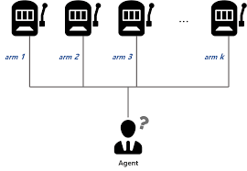
Bandit Optimization Problem
Multi-Armed Bandit Problem: Maximize the expected return from a machine.

Slide 4
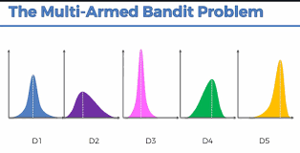
Probability Distributions of Expected Return

Slide 5
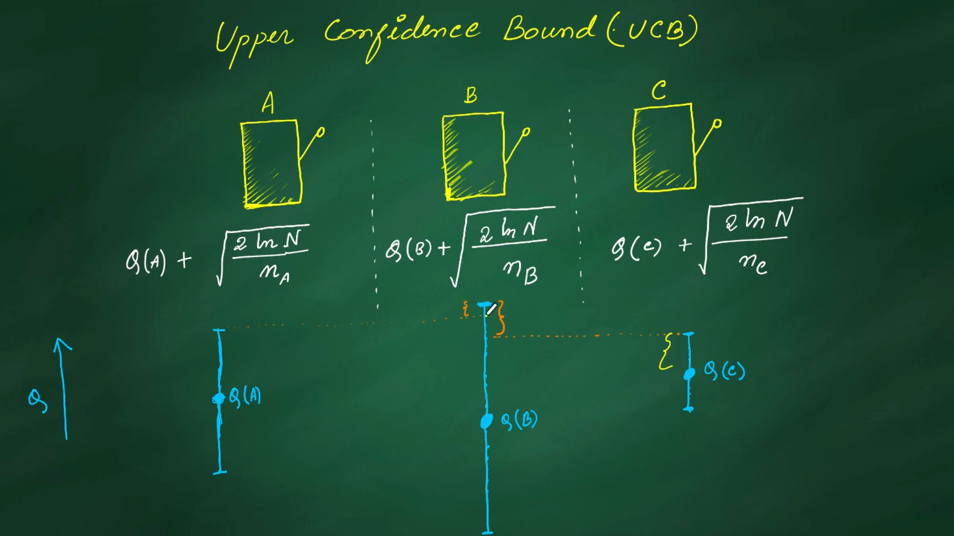
Upper Confidence Bound (UCB) – Q-value estimate approach + Confidence interval

Slide 6
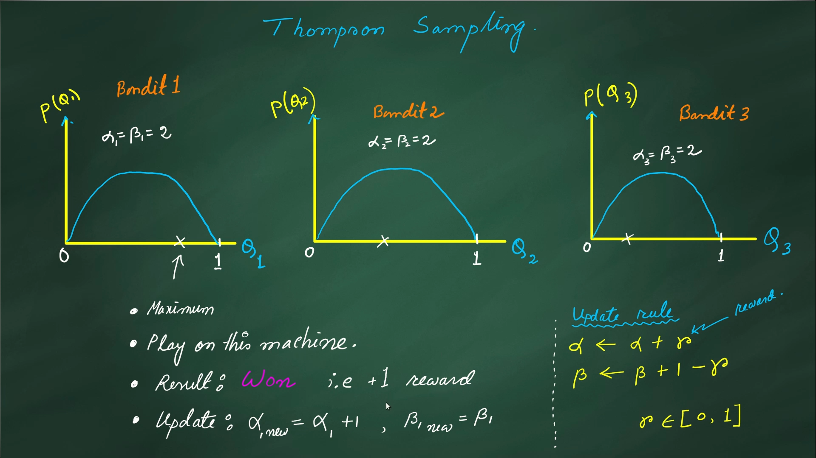
Thompson Sampling-Probabilistic Approach

Slide 7
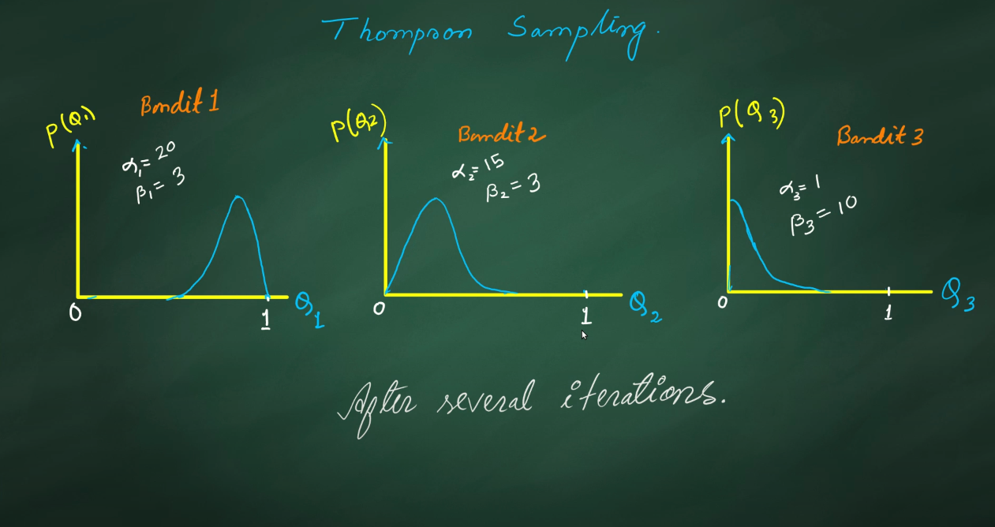
The aim is to obtain a higher Q-value…

Slide 8
Content-1
Bandit Optimization Problem (MAB):
Upper Confidence Bounds
Thompson Sampling
Exploration-Exploitation Trade-off ( Epsilon-Greedy Strategy)
Markov Decision Processes (MDPs)
Richard Bellman - Bellman Optimality Equation- Q-functions
Q-Learning (Reinforcement Learning Technique) → Q-Value Table → Next action to maximize future rewards
Policy Gradients Approach

Slide 9
Markov Decision Processes (MDPs)
Components of a MDP:
Agent
Environment
State (S)
Action (A)
Rewards (R)

Slide 10
What does a MDP mean?
In an MDP, we have a decision maker, called an agent, that interacts with the environment it's placed in.
These interactions occur sequentially over time. At each time step, the agent will get some representation of the environment's state.
Given this representation, the agent selects an action to take.
The environment is then transitioned into a new state, and the agent is given a reward as a consequence of the previous action.

Slide 11
In an MDP, we have a set of states (S), a set of actions (A), and a set of rewards (R). We'll assume that each of these sets has a finite number of elements from a probabilistic distribution.
At each time step t=0,1,2,⋯,T - agent receives some representation of the environment's state St ∈ S. Based on this state, the agent selects an action At ∈ A. This gives us the state-action pair (St,At).
Time is then incremented to the next time step t+1, and the environment is transitioned to a new state St+1 ∈ S. At this time, the agent receives a numerical reward Rt+1 ∈ R for the action At taken from state St. At each time t, we have f(St,At)=Rt+1.
The trajectory representing the sequential process of selecting an action from a state, transitioning to a new state, and receiving a reward can be represented as S0,A0,R1,S1,A1,R2,S2,A2,R3,⋯

Slide 12
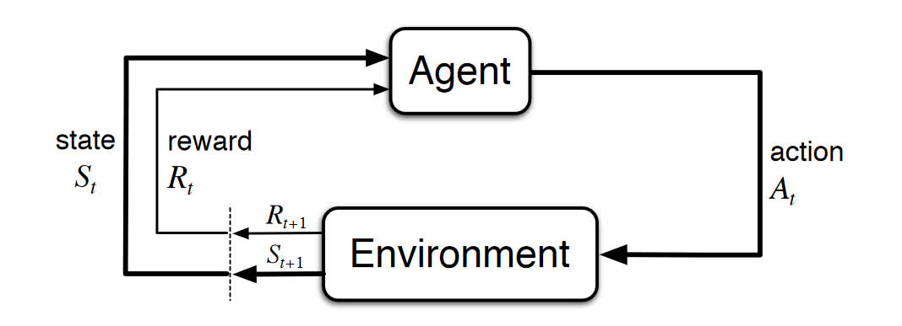
Diagram Illustration

Slide 13
Procedure
Let's break down this diagram into steps:
At time t, the environment is in state St.
The agent observes the current state and selects action At.
The environment transitions to state St+1 and grants the agent reward Rt+1.
This process then starts over for the next time step, t+1.
Note, t+1 is no longer in the future, but is now the present. When we cross the dotted line on the bottom left, the diagram shows t+1 transforming into the current time step t so that St+1 and Rt+1 are now St and Rt.

Slide 14

Concept of Expected Return
The goal of an agent in an MDP is to maximize its cumulative rewards. We need a way to aggregate and formalize these cumulative rewards. For this, we introduce the concept of the expected return of the rewards at a given time step.
For now, we can think of the return simply as the sum of future rewards. Mathematically, we define the return G at time t as Gt=Rt+1+Rt+2+Rt+3+⋯+RT, where T is the final time step.
It is the agent's goal to maximize the expected return of rewards.

Slide 15
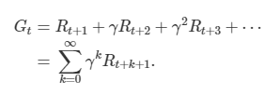
Discounted Factor (γ)
It is the agent's goal to maximize the expected discounted return of rewards.
To define the discounted return, we first define the discount rate, γ, to be a number between 0 and 1.
The discount rate will be the rate for which we discount future rewards and will determine the present value of future rewards.
Our agent will care more about the immediate reward over future rewards since future rewards will be more heavily discounted.
So, while the agent does consider the rewards it expects to receive in the future, the more immediate rewards have more influence when it comes to the agent making a decision about taking a particular action.

Slide 16

Cumulative discounted return (G)

Slide 17
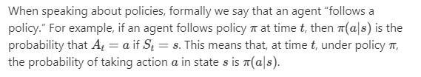
Policy(π) and Value Functions
How probable is it for an agent to select any action from a given state? - Policy
How good is a specific action or a specific state for the agent? – Value Function
NOTE: It will always help the agent to maximize its return if it knows the policy and value functions beforehand.
A policy is a function that maps a given state to probabilities of selecting each possible action from that state. We will use the symbol π to denote a policy.

Slide 18
Value function
Value function → Expected return → The way the agent acts → Policy
Value functions are functions of states, or of state-action pairs, that estimate how good it is for an agent to be in a given state, or how good it is for the agent to perform a given action in a given state.
Types of value-functions:
F(States) – State-value function:

Slide 19
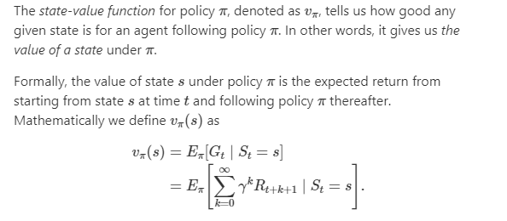

Slide 20
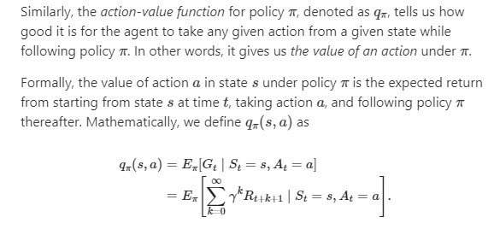
Q-value function-Basis for RL optimization algos
F(State, Action) – Action-value function

Slide 21
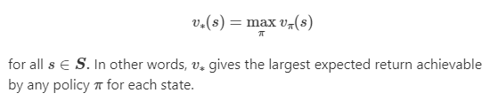
Optimality and Optimal policies/value functions
It is the goal of reinforcement learning algorithms to find a policy that will yield a lot of rewards for the agent if the agent indeed follows that policy.
Specifically, reinforcement learning algorithms seek to find a policy that will yield more return to the agent than all other policies.
Optimal policy – If a policy yields a larger expected return compared to all other policies, then the policy is said to be optimal and the agent is likely to follow the policy (behaviour).
Optimal state-value function: Every optimal policy has an associated optimal state function with it.

Slide 22
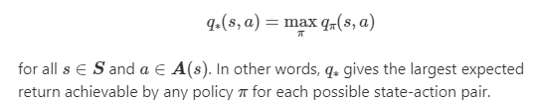
Optimal action-value function:
How can we determine whether an action-value function is optimal?
For any state-action pair, the function produces the expected reward for taking that action plus the maximum discounted return thereafter.

Slide 23

Bellman Optimality Equation (Optimal Q-value function) - Target
One fundamental property of q∗ is that it must satisfy the following equation.
We can use the Bellman equation to find q∗. Once we have q∗, we can determine the optimal policy because, with q∗, for any state s, a reinforcement learning algorithm can find the action a that maximizes q∗(s,a).

Slide 24
Q-Learning - A RL technique
Q-Learning is an algo which can be used to find the optimal policy by learning the Q-values for each state-action pair.
Iteratively updates the Q-values of each state-action pair using the Bellman equation until it converges to an optimal Q-function (q*), this is also called as value-iteration.
In a deterministic environment, we use a Q-table for denoting and updating the Q-values for all the state-action pairs.
How does the agent make its first move, and decide which action to take from the given state to maximize its rewards.

Slide 25
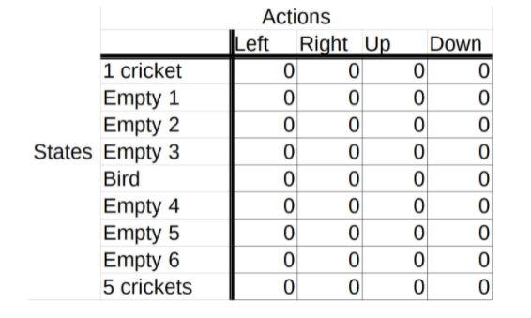
A Q-table

Slide 26
Exploration-Exploitation Trade-off (Epsilon-Greedy Strategy)
Define an exploration rate ϵ that we initially set to 1. This exploration rate is the probability that our agent will explore the environment rather than exploit it. With ϵ=1, it is 100% certain that the agent will start out by exploring the environment.
As the agent learns more about the environment, at the start of each new episode, ϵ will decay by some rate that we set so that the likelihood of exploration becomes less and less probable as the agent learns more and more about the environment.
The agent will become “greedy” in terms of exploiting the environment once it has had the opportunity to explore and learn more about it.

Slide 27
To determine whether the agent will choose exploration or exploitation at each time step, we generate a random number between 0 and 1.
If this number is greater than epsilon, then the agent will choose its next action via exploitation, it will choose the action with the highest Q-value for its current state from the Q-table.
Otherwise, its next action will be chosen via exploration, randomly choosing its action and exploring what happens in the environment.

Slide 28

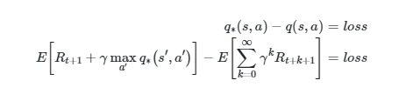
Updating the Q-value

Slide 29
So, our new Q-value is equal to a weighted sum of our old value and the learned value.
The old value in our case is 0 since this is the first time the agent is experiencing this particular state-action pair, and we multiply this old value by (1−α).
Our learned value is the reward the agent receives from moving right from the starting state plus the discounted estimate of the optimal future Q-value for the next state-action pair (s′,a′) at time t+1.
This entire learned value is then multiplied by our learning rate.

Slide 30
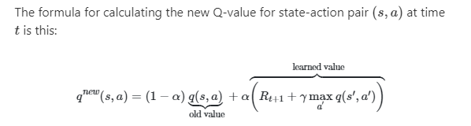
The formula for new Q-value

Slide 31
Content-2 (Deep Reinforcement Learning)
Using the power of Deep Learning with Reinforcement Learning.
We need function approximators-Neural Networks for complex environments --→ Deep Q-Learning
Deep Q-Networks
The environment states given as input to the DQN and the outputs are the state-action pairs (Q-function) which are the ones given by the Neural Network
The loss is the difference between the Q-function and the optimal bellman optimal Q-function, which needs to be minimized and convergence between both needs to be achieved.
This training is done through experience replay and gradient descent to update the weights of the neural networks.
This is done until the optimal Q-value is reached and the loss converges.

Slide 32
But what happens when the environment-agent pair gets complex?

Slide 33
Experience Replay during training DQNs
Experience Replay And Replay Memory
With deep Q-networks, we often utilize this technique called experience replay during training. With experience replay, we store the agent's experiences at each time step in a data set called the replay memory. We represent the agent's experience at time t as et.
At time t, the agent's experience et is defined as this tuple:
et=(st,at,rt+1,st+1)
This tuple contains the state of the environment st, the action at taken from state st, the reward rt+1 given to the agent at time t+1 as a result of the previous state-action pair (st,at), and the next state of the environment st+1. This tuple indeed gives us a summary of the agent's experience at time t.

Slide 34
Deep Q-Networks-Training
The network is passed a state from the environment, and in turn, the network outputs the Q-value for each action that can be taken from that state.
Initialize replay memory capacity.
Initialize the network with random weights.
For each episode:
Initialize the starting state.
For each time step:
Select an action.
Via exploration or exploitation
Execute selected action in an emulator.
Observe reward and next state.
Store experience in replay memory.

Slide 35
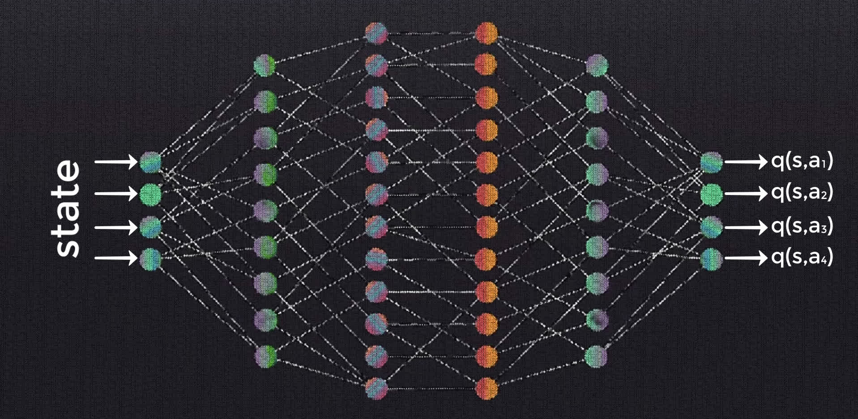
Deep Q-Networks with experience replay

Slide 36

Policy Networks-Training
We'll refer to this network as the policy network since its objective is to approximate the optimal policy by finding the optimal Q-function.
In this case, minimizing the loss means that we're aiming to make the policy network output Q-values for each state-action pair that approximate the target Q-values given by the Bellman equation.

Slide 37

MAXQ function
In order to find this max term now, what we do is pass s′ to the policy network, which will output the Q-values for each state-action pair using s′ as the state and each of the possible next actions as a′.
Given this, we can obtain the max Q-value over all possible actions taken from s′,

Slide 38
Why do we need to calculate this term again?
This term enables us to compute the loss between the Q-value given by the policy network for the state-action pair from our original experience tuple and the target optimal Q-value for this same state-action pair.

Slide 39
5.Sample random batch from replay memory.
6.Preprocess states from batch.
7.Pass batch of preprocessed states to policy network.
8.Calculate loss between output Q-values and target Q-values.
Requires a second pass to the network for the next state.
9.Gradient descent updates weights in the policy network to minimize loss.

Slide 40
Hierarchical Reinforcement Learning
Breaking down a large RL problem which is to be solved by the agent into small sub-problems and combining them back again to solve the bigger problem.
This is more of a divide and conquer approach to a RL problem.
Advantages:
Temporal abstraction
Transfer/Reusability
Powerful state abstraction

Slide 41
Policy Gradient Approach
Reinforcement learning algorithms tend to fall into two distinct categories: value based and policy based learning.
Approximate the agent’s policy rather than the action value function. In many cases, this is a much simpler function to approximate and therefore the chances of getting trapped in local minima are reduced.
The rewards are sampled from the environment.
These rewards are used to weight the gradient descent such that the agent assigns a higher probability to the actions that lead to higher future returns, and less probability to those actions that lead to lower future returns.

Slide 42
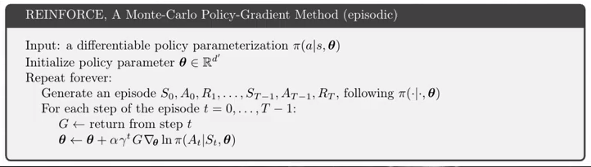
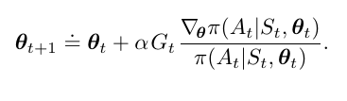

Slide 43
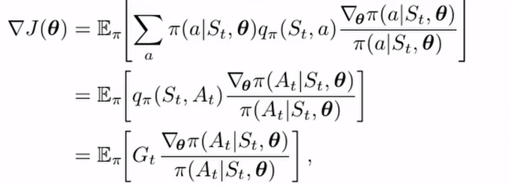
Advantages:
Higher chance of convergence of the optimization function atleast in the local minima.
Moving in the direction of the gradient - Gradient Ascent

Slide 44
Context ahead…
Temporal Difference algorithm (TD)
Policy Gradients (Better convergence and compact representation)
Actor-Critic-Reinforce
Other Monte - Carlo Methods
Lifelong Reinforcement Learning

